Slide 1
Inventory Management System

Slide 2
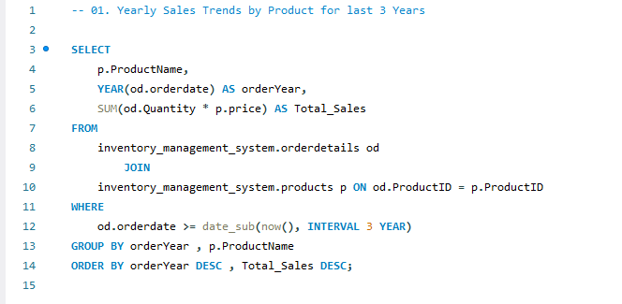
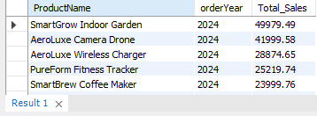
1. Yearly Sales Trends by Product for last 3 Years
MySQL Query
Its Result

Slide 3
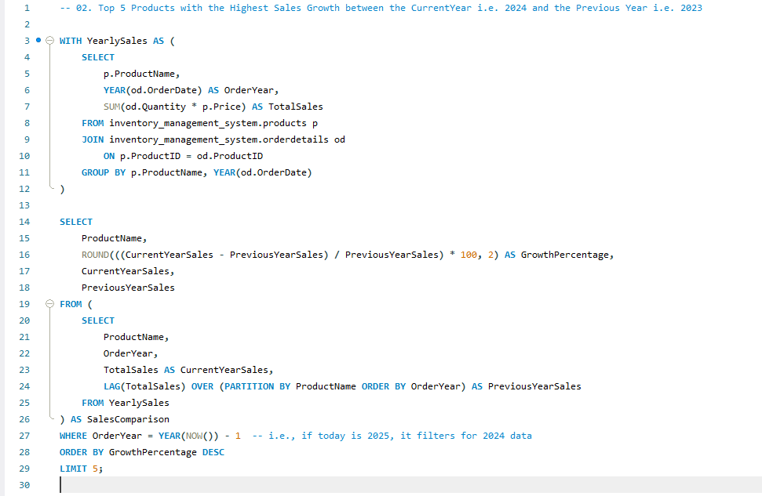
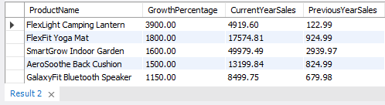
02. Top 5 Products with the Highest Sales Growth between the Current Year i.e., 2024 and the Previous Year i.e., 2023
MySQL Query
Its Result

Slide 4
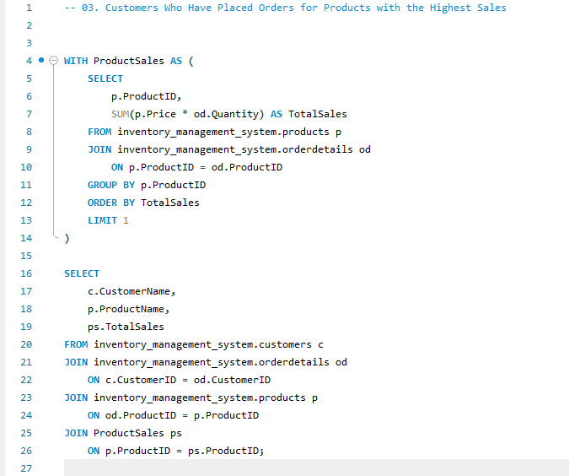
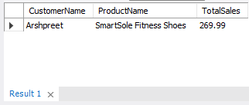
3. Customers Who Have Placed Orders for Products with the Highest Sales
MySQL Query
Its Result

Slide 5
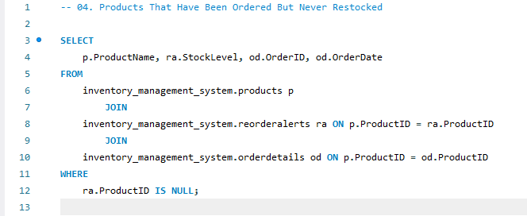
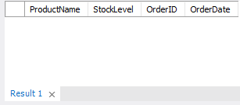
4. Products That Have Been Ordered But Never Restocked
MySQL Query
Its Result

Slide 6
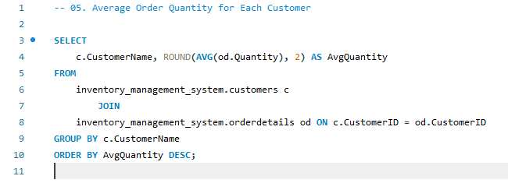
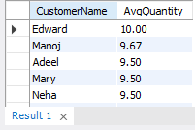
5. Average Order Quantity for Each Customer
MySQL Query
Its Result

Slide 7
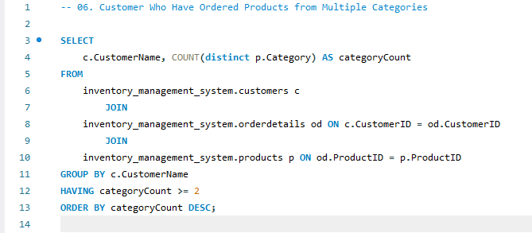
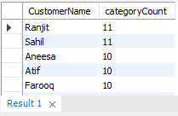
6. Customer Who Have Ordered Products from Multiple Categories
MySQL Query
Its Result

Slide 8
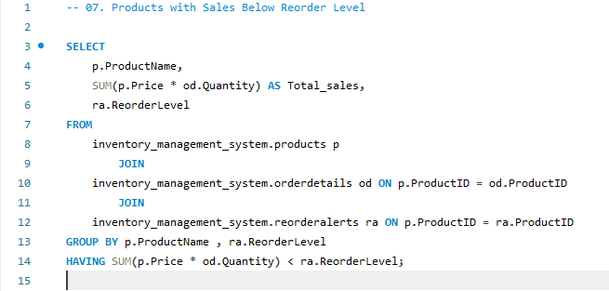
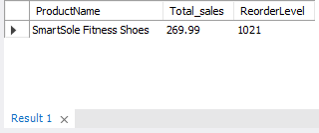
7. Products with Sales Below Reorder Level
MySQL Query
Its Result

Slide 9
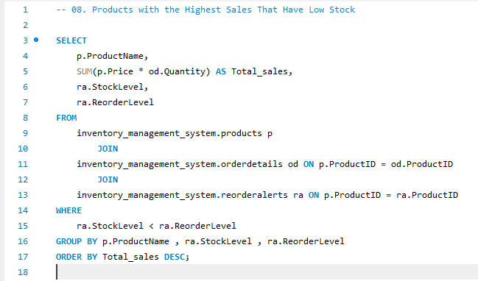
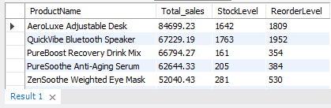
8. Products with the Highest Sales That Have Low Stock
MySQL Query
Its Result

Slide 10
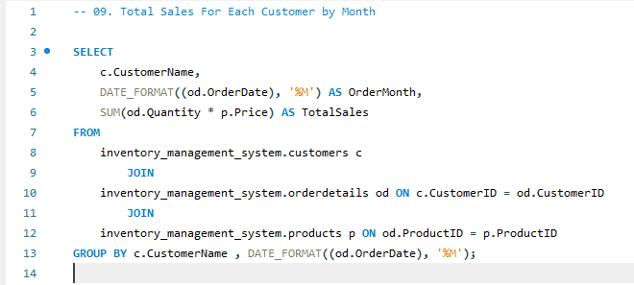
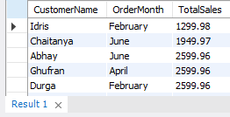
9. Total Sales For Each Customer by Month
MySQL Query
Its Result

Slide 11
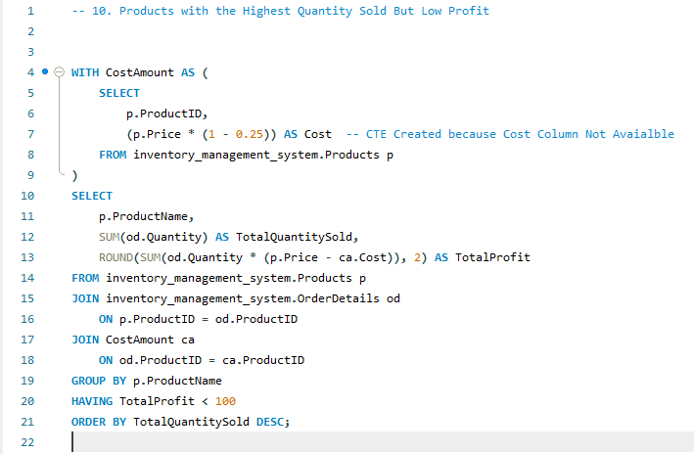
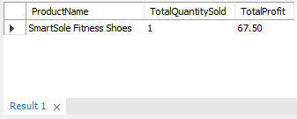
10. Products with the Highest Quantity Sold But Low Profit
MySQL Query
Its Result

Slide 12
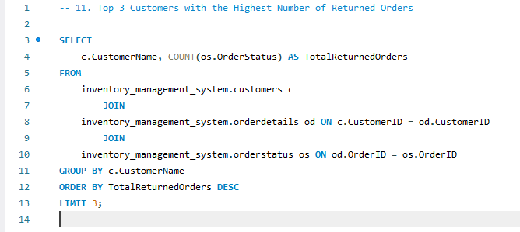
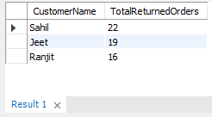
11. Top 3 Customers with the Highest Number of Returned Orders
MySQL Query
Its Result

Slide 13
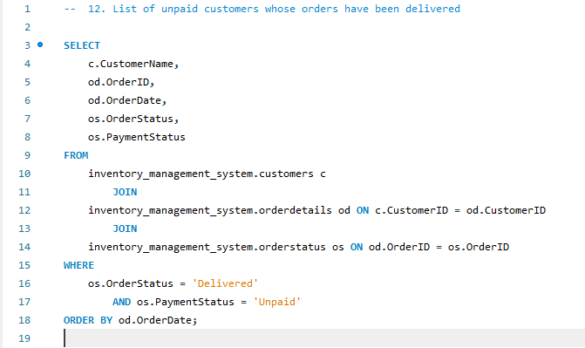
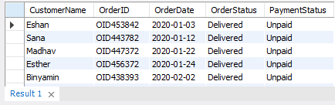
12. List of unpaid customers whose orders have been delivered
MySQL Query
Its Result

Slide 14
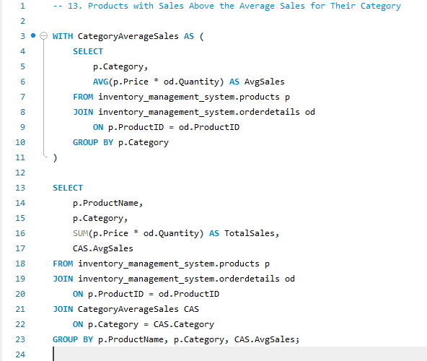
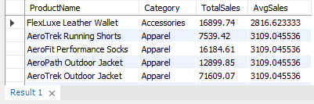
13. Products with Sales Above the Average Sales for Their Category
MySQL Query
Its Result

Slide 15
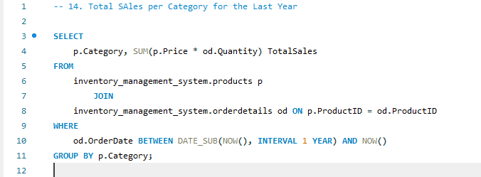
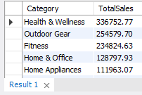
14. Total Sales per Category for the Last Year
MySQL Query
Its Result

Slide 16
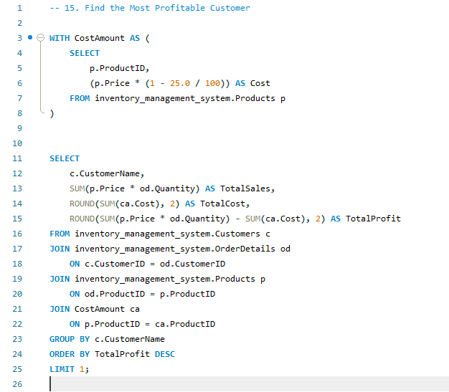
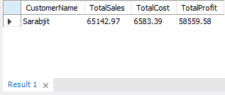
15. Find the Most Profitable Customer
MySQL Query
Its Result

Slide 17
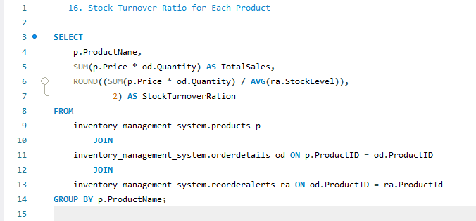
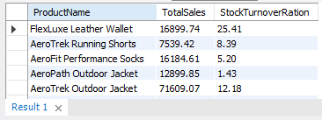
16. Stock Turnover Ratio for Each Product
MySQL Query
Its Result

Slide 18
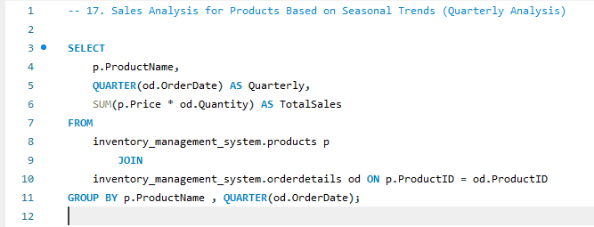
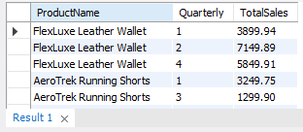
17. Sales Analysis for Products Based on Seasonal Trends (Quarterly Analysis)
MySQL Query
Its Result

Slide 19
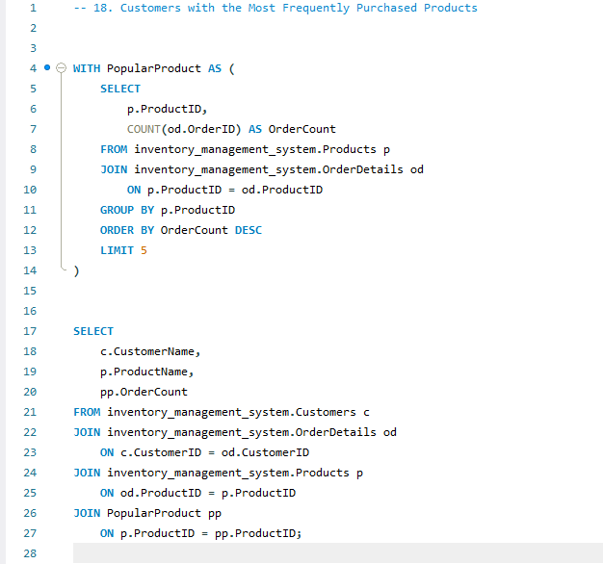
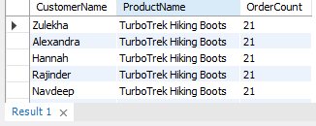
18. Customers with the Most Frequently Purchased Products
MySQL Query
Its Result

Slide 20
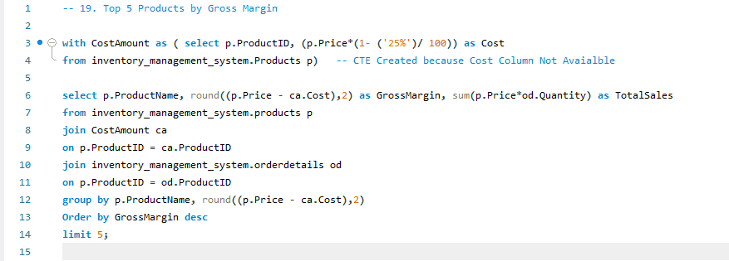
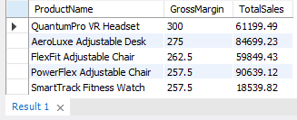
19. Top 5 Products by Gross Margin
MySQL Query
Its Result

Slide 21
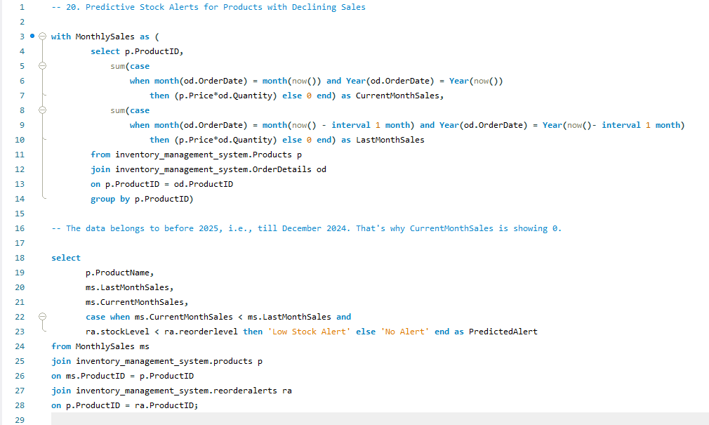
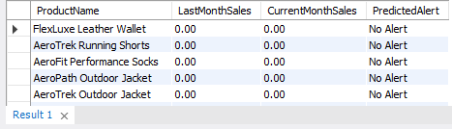
20. Predictive Stock Alerts for Products with Declining Sales
MySQL Query
Its Result

Slide 22
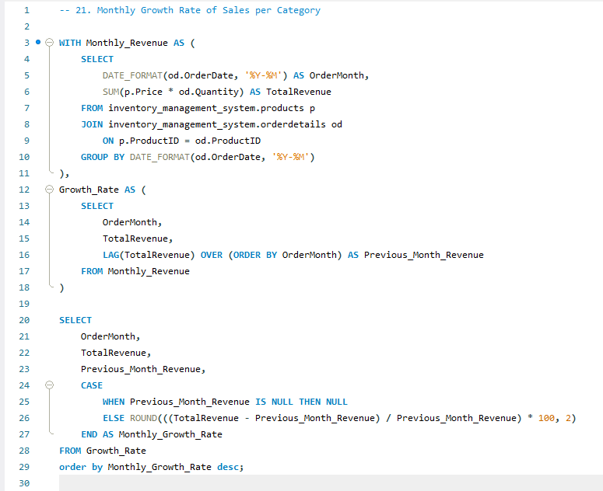
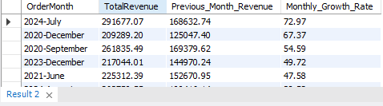
21. Monthly Growth Rate of Sales per Category
MySQL Query
Its Result

Slide 23
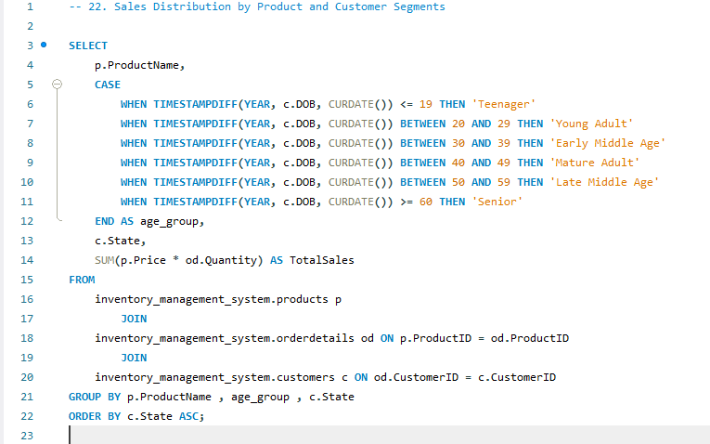
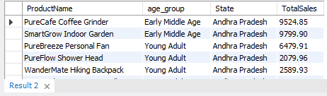
22. Sales Distribution by Product and Customer Segments
MySQL Query
Its Result

Slide 24
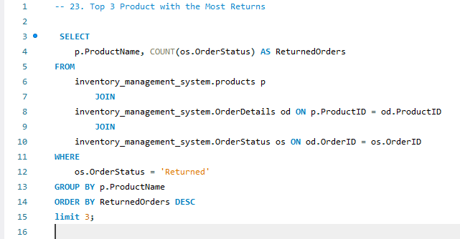
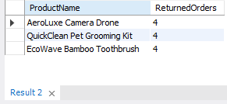
23. Top 3 Product with the Most Returns
MySQL Query
Its Result

Slide 25
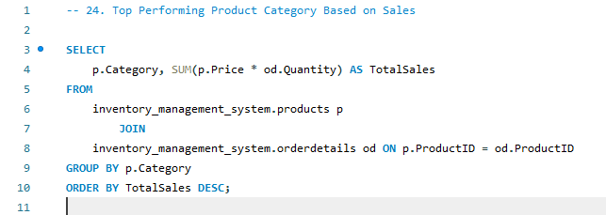
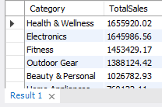
24. Top Performing Product Category Based on Sales
MySQL Query
Its Result

Slide 26
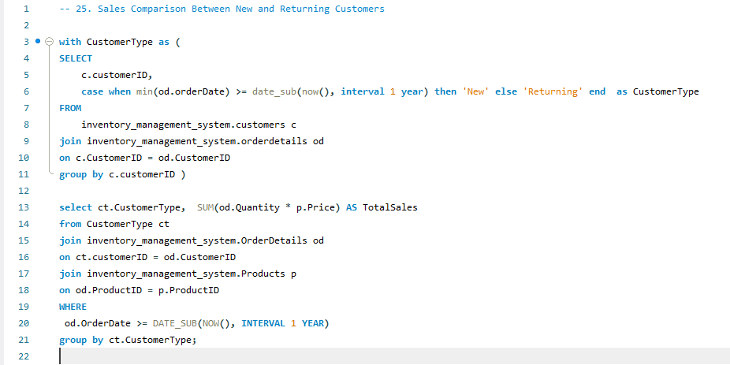
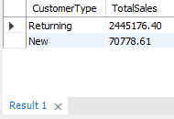
25. Sales Comparison Between New and Returning Customers
MySQL Query
Its Result

Slide 27


26. Profitability analysis for Products by Supplier
MySQL Query
Its Result

Slide 28


27. Inventory to Sales Ratio for Each Product
MySQL Query
Its Result

Slide 29


28. Customers Who Have Ordered High-Value Products (Above Rs. 10000)
MySQL Query
Its Result

Slide 30


29. Sales Impact Analysis After Promotional Discount
MySQL Query
Its Result

Slide 31


30. Top 5 Products by Net Profit
MySQL Query
Its Result

